Slide 1


Sales Analysis Dashboard
Presented By:
Raunak Sen

Slide 2


Company Background
Amazon is an American multinational e-commerce company that faces different challenges while running its business.
To address the problems, the company leverages data-driven insights for operations optimization.
The company offers various services, including Amazon.com, Amazon Alexa, Amazon Appstore, Amazon Luna, Amazon Music, and Amazon Pay.
The owner of the company is Jeff Bezos, and the revenue of the company is USD 637.9 billion.
It has 1,556,000 employees, operating income, and net income of USD 68.59 billion and USD 59.25 billion.

Slide 3


Problem Statement
1
Sales performance varies across months and regions, making it hard to predict whether growth will occur.
2
A significant portion of orders are cancelled or returned, indicating potential issues in product quality, customer expectations, or delivery experience.
3
Delays in shipping, especially from merchant-fulfilled orders, are leading to poor customer experience.
4
The company lacks detailed insight into customer segments, regional performance, and retention behavior.
5
Stockouts or overstocking of certain products affects both customer satisfaction and operational costs.
6
The business needs to harness data analytics to understand these challenges, uncover patterns, and implement targeted improvements across finance, logistics, product management, and customer experience.

Slide 4




Solution
1
2
3
4
5
Identify high-sales months from revenue trend analysis and plan promotions accordingly.
Use the data to identify products or SKUs with high return/cancellation rates.
Encourage migration to Amazon FBA or Easy Ship for better delivery success rates.
Use average quantity ordered and sales trends by category/size to plan inventory replenishment.
Segment customer orders using the B2B field in the dataset.
6
7
8
9
10
First, I have used Python based on an Excel sheet to perform EDA to clean the data and get accurate results, which I have performed in Google Colab.
Based on that, I have performed Power BI based on the same Excel sheet to get the dashboard of the project with the same values as per the Google Colab.
A live Power BI dashboard has been created to monitor the KPIs like revenue, AOV, cancellation rate, and fulfillment lag continuously.
The automated alerts have been set up when the KPIs fall below the threshold.
The historical data has been used for predictive insights.

Slide 5
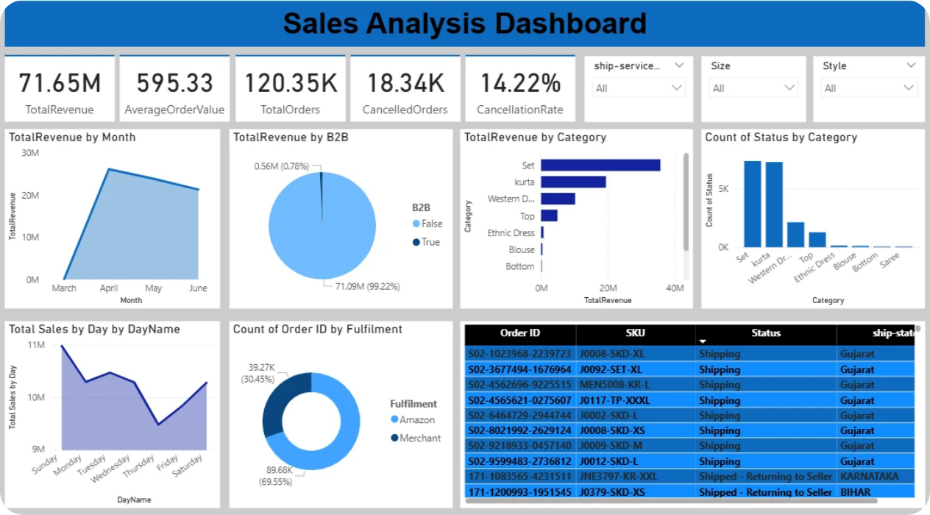
Dashboard

Slide 6


Different DAX Formulas
TotalRevenue = SUM('sales_dataset[1]'[Cleaned_Amount])
AverageOrderValue = DIVIDE(SUM('sales_dataset[1]'[Cleaned_Amount]), DISTINCTCOUNT('sales_dataset[1]'[Order ID]))
TotalOrders = DISTINCTCOUNT('sales_dataset[1]'[Order ID])
CancelledOrders = CALCULATE(COUNTROWS('sales_dataset[1]), 'sales_dataset[1]'[Status] = "Cancelled")
CancellationRate = DIVIDE(CALCULATE(COUNTROWS('sales_dataset[1]), 'sales_dataset[1]'[Status] = "Cancelled"), COUNTROWS('sales_dataset[1]))
DayTable = DATATABLE("DayName", STRING, "DayNum", INTEGER, {{"Sunday", 1}, {"Monday", 2}, {"Tuesday", 3}, {"Wednesday", 4}, {"Thursday", 5}, {"Friday", 6}, {"Saturday", 7}})
Cleaned_Amount = IF(SEARCH("Cancelled", [Status], 1, 0) > 0, 0, [Amount])
DayName = FORMAT('sales_dataset[1]'[Date], "dddd")
DayNum = WEEKDAY('sales_dataset[1]'[Date], 1)
MonthName = FORMAT('sales_dataset[1]'[Date], "MMMM")
MonthNum = MONTH('sales_dataset[1]'[Date])

Slide 7


Different KPI Cards
1
TotalRevenue indicates the total sales amount generated over the entire period analyzed.
2
AverageOrderValue is calculated as total revenue divided by the total number of orders.
3
TotalOrders represents the total number of orders placed.
4
CancelledOrders indicates that a total of 18,340 orders were cancelled.
5
CancellationRate describes that 14 out of every 100 orders were cancelled.
6
This set of KPI cards gives us a high-level summary of business performance.
7
The company generated 71.65 million rupees in revenue from over 120,000 orders.
8
The average order value is 595.33 rupees, which provides a benchmark for customer spend.
9
However, 14.22% of orders were cancelled - that’s more than 18,000 orders - signaling a potential problem in either logistics or customer expectations.
10
Reducing this cancellation rate could directly improve revenue and customer satisfaction.

Slide 8

Conclusion
Monthly revenue analysis reveals clear peaks during certain months, likely due to festive seasons or promotions.
A few product categories contribute disproportionately to total revenue.
It indicates the need to improve merchant handling processes.
B2C orders experience more frequent cancellations compared to B2B.
Average order quantity patterns can inform restocking and bundling strategies.
The company has strong revenue potential but needs to address fulfillment delays, customer dissatisfaction, and product-level inefficiencies to grow sustainably.

Slide 9

Recommendations
Launch targeted campaigns and bundle offers during these periods to maximize sales.
Where feasible, shift more fulfillment responsibility to Amazon’s logistics for reliability.
Investigate top-returned products and refine product descriptions or quality control.
Use B2B vs. B2C behavior patterns to design segment-specific campaigns and loyalty offers.
Use average quality orders and product demand to forecast inventory needs.
By aligning strategies with customer behavior, seasonal trends, and fulfillment efficiency, the company can reduce costs, improve satisfaction, and boost revenue.

Slide 10

Thank You
GitHub ID
https://github.com/raunaksen26101997
LinkedIn ID
https://www.linkedin.com/in/raunak-sen-6a9848184?lipi=urn%3Ali%3Apage%3Ad_flagship3_profile_view_base_contact_details%3BAo6K6VVXSZSzqMbPOXKYAw%3D%3D

